Slide 1


Slide 2
Core Business Challenges
Extreme Demand Volatility
Fragmented Customer Journeys
Inventory Misalignment
Promotional Noise

Slide 3
KPI
Total Sale – 5 Billion
Average Purchase – 9.26K
Total Transactions – 550K
Total Unique Customers-5891
Total Repeat Customers – 5891
Total Unique Products- 3631
Repeat Purchase Rate – 100%

Slide 4
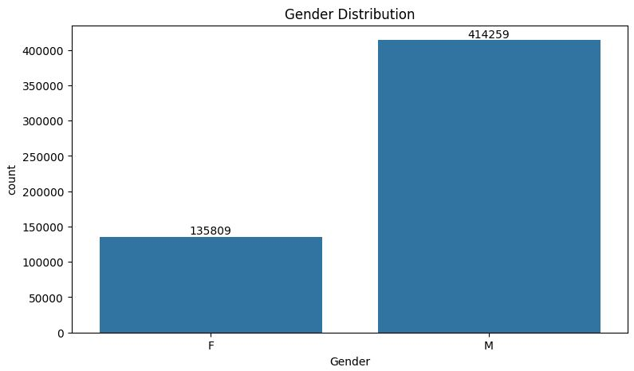
From this graphs we can see that most of the buyers are males.

Slide 5
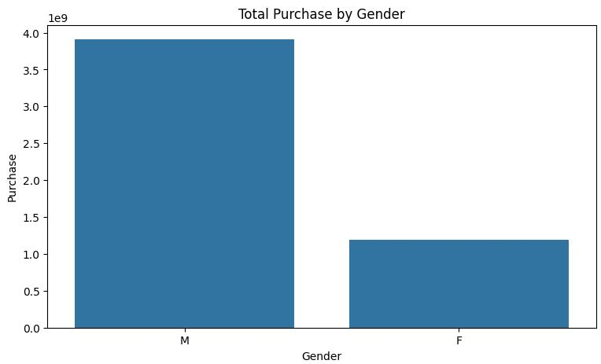
From this graphs we can see that the purchasing power of males are greater than females.

Slide 6
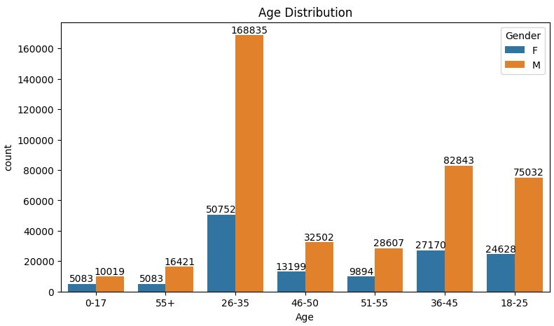
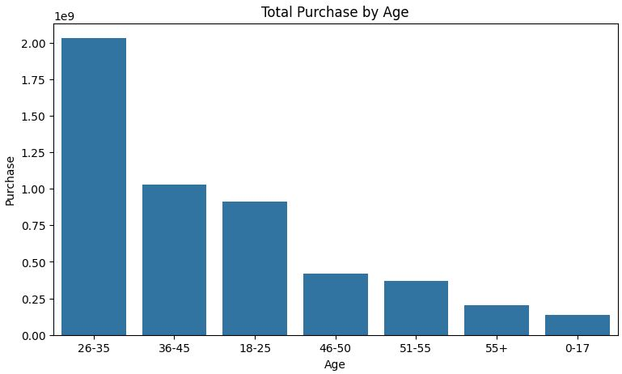
From these graphs we can see that most of the buyers are of the age group between 26-35 years male.

Slide 7
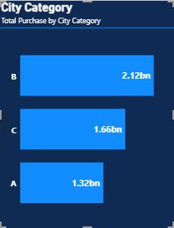
Geographic Performance (Total Purchase by City Category)
This bar chart breaks down revenue by the type of city where the purchase occurred:
Top Performer (City B): This category leads in revenue with 2.12bn in total purchases.
Middle Performer (City C): City Category C follows with 1.66bn.
Lower Performer (City A): This category generated the lowest revenue of the three at 1.32bn.

Slide 8
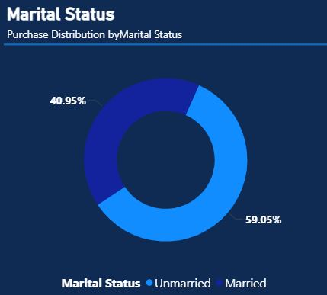
59.05% of buyers are unmarried and 40.95% are married.
There is an 18.1% lead in purchasing activity by unmarried customers compared to married customers.

Slide 9
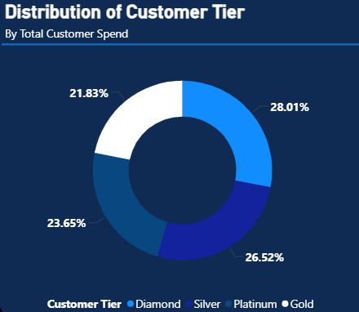
28.01% of buyers are Diamond tier (Total_Spend greater than or equal to 1 Million)
23.65% of buyers are Platinum tier (Total_Spend greater than or equal to 0.5 Million and less than 1 Million)
21.83% of buyers are Gold tier (Total_Spend greater than or equal to 0.25 Million and less than 0.5 Million)
26.52% of buyers are Silver tier (Total_Spend less than 0.25 Million)
Combined, the top-tier Diamond and Platinum groups make up over 51% of the total customer count, indicating strong high-level engagement.

Slide 10
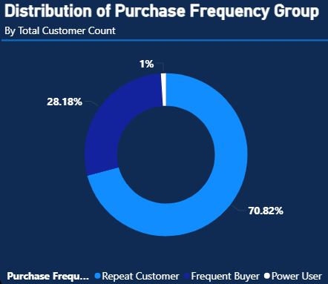
Repeat Customer - 70.82% (1< Transaction Count<=100)
Frequent Buyer – 28.18% (100<Transaction Count<=500)
Power User – 1% (Transaction Count>500)

Slide 11
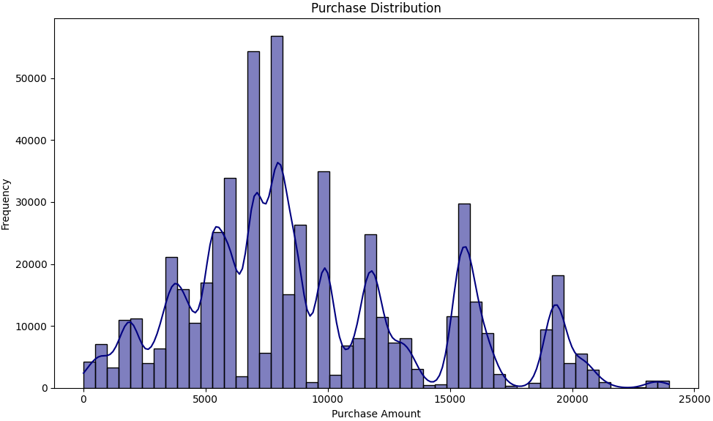
The distribution of purchase amounts is right-skewed, meaning most purchases are for lower values.
There is a high frequency of purchases in the lower to mid-range of amounts between 5K to 10K.
Fewer purchases occur at very high amounts, indicating that high-value transactions are less common but exist.

Slide 12
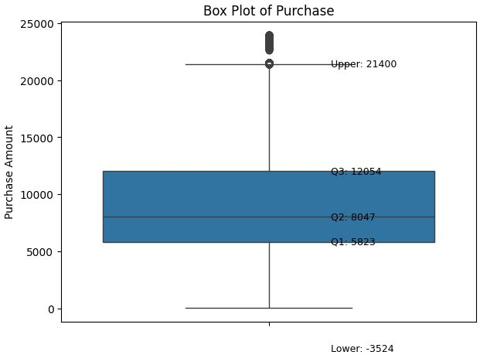
Central Tendency: The median purchase amount (Q2) is 8,047.
The "Middle 50%": Most customers spent between 5,823 (Q1) and 12,054 (Q3).
The Outliers: The plot shows a significant number of "outliers" (the black dots at the top) that exceed the upper whisker of 21,400. These represent high value transactions that are far above the typical customer spend.

Slide 13
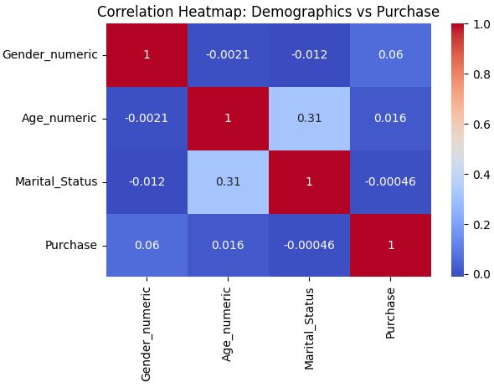
Gender and Purchase: There's a very weak positive correlation (around 0.06) between gender and Purchase, suggesting males tend to have slightly higher purchase amounts, but the relationship is not strong.
Age and Purchase: The correlation between age and Purchase is almost negligible (around 0.016), indicating that age has very little linear influence on purchase amount.
Marital Status and Purchase: There is virtually no linear correlation (around -0.00046) between marital status and purchase amount, meaning whether someone is married or not doesn't seem to impact their spending directly.
Age and Marital Status: A moderate positive correlation (around 0.31) exists between age and marital status, implying that older individuals are more likely to be married in this dataset.

Slide 14
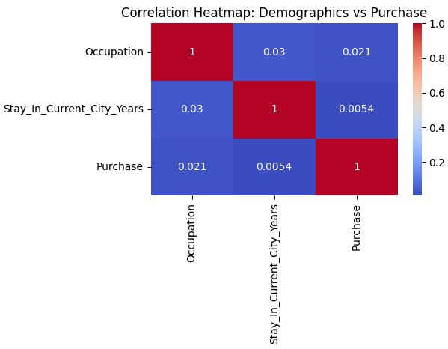
Very Weak Correlation with Purchase: Both 'Occupation' and 'Stay In Current City Years' show extremely weak positive correlations with 'Purchase' (0.02 and 0.005). This suggests that there is almost no linear relationship between a person's occupation or the duration of their stay in the current city and the amount they spend.
Minimal Inter-Variable Correlation: The correlation between 'Occupation' and 'Stay In Current City Years' is also very weak (0.03), indicating these two demographic factors are largely independent of each other within this dataset.

Slide 15
T-test Analysis
T-test to compare Average Purchase by Gender:
P-value: 0.000
Since the p-value (0.000) is much less than our common significance level of 0.05, There is a statistically significant difference in average purchase amounts between genders.
Mean Difference: Males had an average purchase of $9437.53, while females had $8734.57. This means males, on average, spent $702.96 more than females.
T-test to compare Average Purchase by Marital Status:
P-value: 0.731
Since the p-value is greater than 0.05, There is no statistically significant difference in average purchase amounts between individuals with different marital statuses.
Mean Difference: The average purchase for married individuals was $9261.17, and for unmarried individuals was $9265.91. The difference of -$4.73 is very small and not statistically significant.

Slide 16
ANOVA Analysis
ANOVA to analyze spending differences across age group:
P-value: 0.000
Since the p-value is less than 0.05, There is a statistically significant difference in average purchase amounts among the age groups.
Average Purchases: The age group 51-55 had the highest average purchase ($9534.81), while the 0-17 age group had the lowest ($8933.46).
ANOVA to analyze spending differences across city category:
P-value: 0.000
Since the p-value (0.000) is less than 0.05, There is a statistically significant difference in average purchase amounts among the city categories.
Average Purchases: City Category C had the highest average purchase ($9719.92), followed by City Category B ($9151.30), and City Category A ($8911.94).

Slide 17
Recommendation
Bridge the Gender Gap: Develop specific marketing campaigns to attract female shoppers, as they currently represent only about 25%.
Focus on Young Professionals: Optimize ad spend toward the 30–40 age demographic, which currently forms the backbone of your purchasing volume.
Upsell to "Diamond" Status: With a balanced distribution across tiers, launch an "Elite Upgrade" program to move Silver (26.5%) and Platinum (23.6%) members into the high-spending Diamond (28%) category.
. Convert Repeaters to Frequent Buyers: Implement a "Subscription" or "Early Access" model for the 70.8% of Repeat Customers to increase their purchase velocity and move them into the Frequent Buyer (28.1%) group.

